Slide 1
Office 365
Notes:
Welcome Everyone to the course

Slide 2

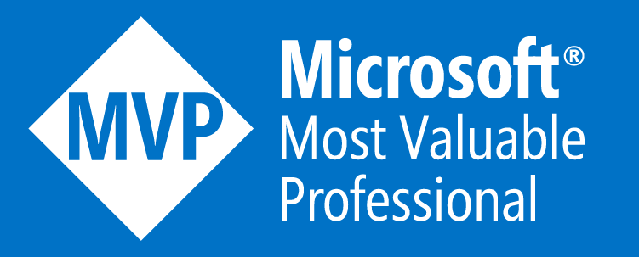
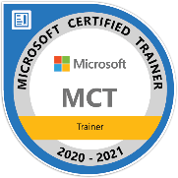










Jenkins NS
Office Development MVP | MCT | Solution Architect | International Speaker | Author
16+ Years of experience
Microsoft Teams, Power Platform and SPFx Specialist
International Speaker | Author | Blogger | Trainer
SPS Bangalore Organizer
aOS Ambassador
jenkinsns@gmail.com
in/jenkinsns
@jenkinsns
http://www.jenkinsblogs.com
jenkinsns
https://www.facebook.com/spfxinfo/
https://www.facebook.com/msteamsinfo
https://www.youtube.com/user/jenkinsns

Slide 3

Hello! Introduce yourself
Let’s get acquainted:
Your name
Title/function
Experience
Your expectations for the course
Notes:
Ask students to introduce themselves and provide their backgrounds, product experience, and expectations for the course.
Record student expectations on a whiteboard or flip chart that you can reference during class.

Slide 4
Microsoft 365 Experience

Slide 5
Lesson Introduction
When configuring your Microsoft 365 tenant, you should know how to:
Set up your organizational profile
Manage your tenant’s subscriptions
Manage your services and add-ins
Finalize your tenant

Slide 6
Setting up Your Organization Profile
Completing your company’s Organization profile is essential for setting up your company’s tenant
You should use the Microsoft 365 Admin Center to edit your organization profile
You must be a Global Admin to edit the Organization profile
You can't change the country or region for your subscription
The country or region where your organization is headquartered determines which services are available to you, the taxes and billing currency, and the location of the data center.
To change your organization's country or region, sign up for a new account, choose the desired country or region, and purchase a new subscription.

Slide 7
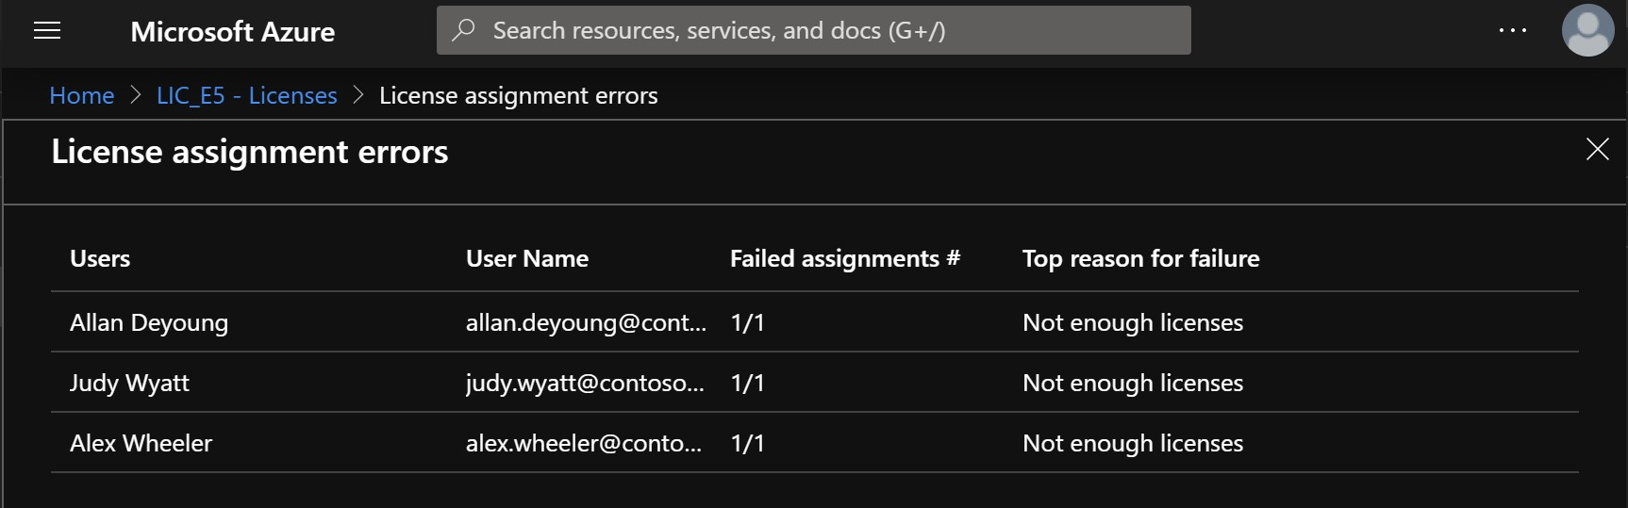
Managing Your Tenant Subscriptions
Maintaining minimum subscription requirements for your company is essential to remaining functional
You can review all active and deprovisioned licenses from the Subscriptions page located under the Billing tab in the Admin Center
Purchasing additional licenses changes the monthly billing date
Additional actions that can be performed from the Subscriptions page include:
Add a partner of record
Add a subscription
Convert a subscription
Purchasing an insufficient number of licenses can result in implementation delays

Slide 8
Managing Your Services and Add-ins
You may need to assign additional licenses, such as Project Online, Visio, or SharePoint Design
These add-on services can be found in the Purchase Services tab, which is located under the Billing section of the Microsoft 365 Admin Center
Some of the subscriptions provide a standard 30-day trial before the service add-on becomes degraded and must be paid for

Slide 9
Finalizing Your Tenant Configuration
You should use the following checklist when finalizing the configuration of your Microsoft 365 tenant:
Have all the users been moved over to Microsoft 365?
Do the users have a functional mailbox and has their data been migrated to their account?
Have all the resources been created?
Have all permissions been established?
Has the vanity domain(s) been moved successfully?
Have all Windows 10 devices been enrolled to Intune?
If the company has SCCM, has co-management been established with Intune?
Has your company established proper governance policies for mobile devices?
Have the DNS records been updated and published globally?
If Azure Active Directory Connect is in place, is the connector properly configured?
If Multi-Factor Authentication is employed, has it been properly configured?
Are the mailing policies in place to protect inbound and outbound mail flow?
Is the Organizational profile set up with the correct information?

Slide 10

Lab Exercises
Exercise 1: Initialize your Lab Environment
Task 1 - Obtain Your Office 365 Credentials
Task 2 - Set up the Organization Profile
Task 3 – Prepare for Microsoft Azure Active Directory
Task 4 – Prepare for External Access using Microsoft Teams

Slide 11
Managing User Accounts and Licenses in Microsoft 365

Slide 12
Lesson Introduction
As the Administrator of your organization’s Microsoft 365 environment, you will be responsible for creating and managing user accounts for all your users.
This includes:
Understanding user identities
Creating user accounts
Managing user accounts
Managing user licenses
Recovering deleted user accounts

Slide 13
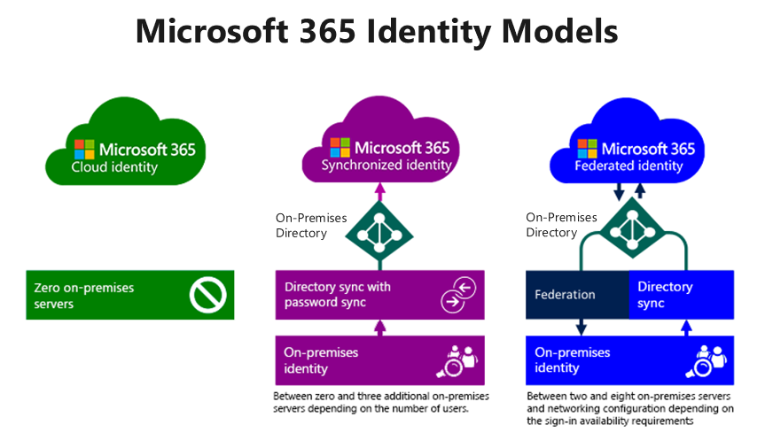
Overview of User Identities
To plan user identities, you must first understand the different user identities in the Microsoft 365 Identity Model:
Cloud identities
Synchronized identities
Federated identities

Slide 14
Creating User Accounts
Depending on your needs, you can use the following methods to provision user accounts:
Microsoft 365 admin center
Import multiple users
Windows PowerShell
Directory synchronization

Slide 15
Managing User Accounts
Managing user accounts involves managing several account settings, such as:
Assigning administrator roles
Setting users’ sign-in status
Specifying user location settings
Assigning licenses
You can use the Microsoft 365 admin center to edit single or multiple users

Slide 16
Managing User Licenses
One of the most basic tasks for Microsoft 365 Administrators is to manage users and manage their licenses
Your organization’s users need licenses to use Microsoft 365 services such as Outlook, SharePoint Online, and Skype for Business Online
When you assign a license to a user, the service is automatically set up for that user
Only members of the Microsoft 365 Global admin and User Management admin roles can assign or remove licenses
To assign a license, you can use the Microsoft 365 admin center or Windows PowerShell

Slide 17
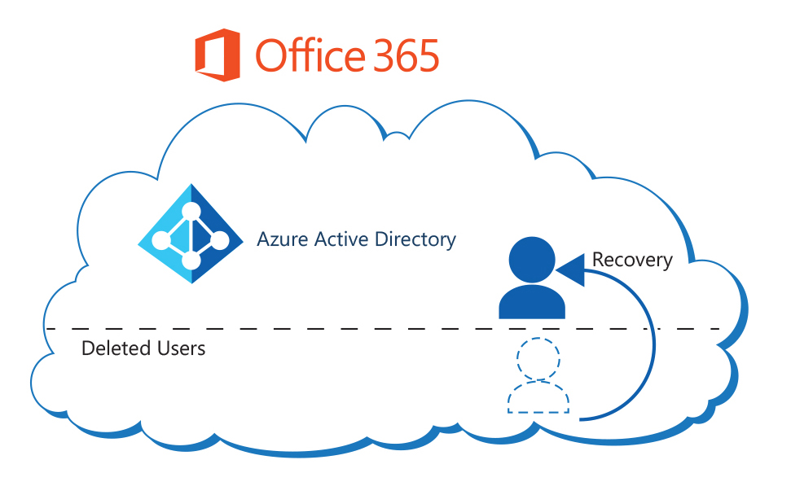
Recovering Deleted User Accounts
When users leave your organization, they usually no longer require a user account in Microsoft 365
When you delete a user account, the assigned Microsoft 365 license for that user becomes available, which you can assign to another user
When you delete a user account, the account becomes inactive and the user cannot sign in to access Microsoft 365 services
Microsoft 365 retains the account as a “soft deleted” inactive account for 30 days after deletion; this enables you to restore the account if necessary
You can restore deleted user accounts using the Microsoft 365 admin center or Windows PowerShell (by using the Restore-MsolUser cmdlet)
Deleted users are still a part of their managed tenant.
A recovery operation simply re-activates the Azure AD user.

Slide 18
Managing Security Groups in Microsoft 365

Slide 19
Lesson Introduction
After you create your users for the Microsoft 365 tenant, you can optionally create groups for distributing email to multiple users with Exchange Online.
To do this you need to:
Understand groups in Microsoft 365
Understand how to create and manage groups
Understand how to use Azure AD Privileged Identity Management

Slide 20
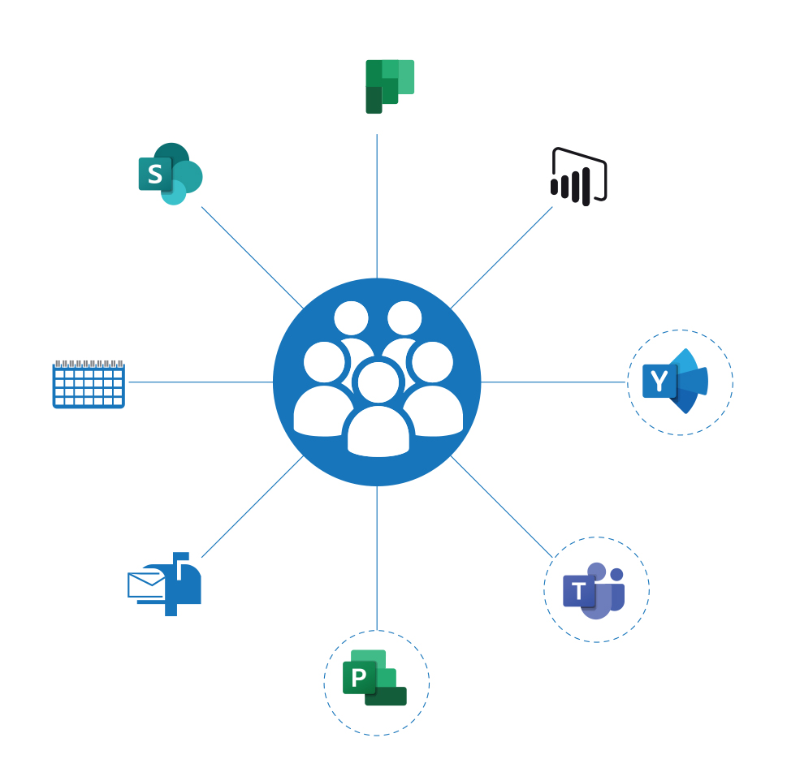
Overview of Groups in Microsoft 365
You can use groups to manage sets of users at the same time in Microsoft 365
Supported types of groups in Microsoft 365 include:
Office 365 group
Distribution list
Mail-enabled security group
Security group
Dynamic distribution group (Exchange only)

Slide 21
Creating and Managing Groups
You can use the Microsoft 365 admin center or Windows PowerShell to create a security group in the Microsoft 365
To ensure that you create and manage your groups correctly, you should consider the following best practices:
Keep your group naming convention simple but clear
Create policies and procedures for ongoing group maintenance
Add users to security groups and then add those security groups to the default groups rather than adding individual users to the default groups
Maintain a consistent and well-defined account provisioning process

Slide 22
Groups in Exchange Online and SharePoint Online
If you want to create groups of users so you can send email to them all at the same time, you can do that in the Exchange admin center:
Distribution group
Security group
Dynamic distribution group
SharePoint groups are created automatically when you make a site collection. A security group you create in SharePoint is only recognized by that SharePoint site collection.
You do not need security groups to be secure.
You can always grant user permissions and access to sites individually.
But with security groups, you can easily manage larger groups of users.
Notes:
Let's take a look at some frequently asked questions related to security groups:
Question: How is a security group different from security groups I create in SharePoint?
Answer: Security groups can be used with SharePoint, Exchange, MDM, Windows, and more. A security group you create in SharePoint is only recognized by that SharePoint site collection.
Question: Do I have to use security groups for my organization to be secure??
Answer: No. This is just one more way you can manage security for your organization. You can always grant user permissions and access to sites individually. But with security groups, you can easily manage larger groups of users.
Question: Can I send email to a security group?
Answer: Yes. But if you want to use groups for email and collaboration, it is recommended that you create an Office 365 group instead.

Slide 23
Lab Exercises (continued)
Exercise 2: Manage Users and Groups
Task 1 - Create a User Account for Adatum’s Enterprise Administrator
Task 2 - Create and Manage Groups
Task 3 - Recover Groups using PowerShell

Slide 24
Microsoft 365 Permission Model Overview
Microsoft 365 provides several predefined administrator roles that you can assign to users in your organization to ease administrative burdens
The permission model in Microsoft 365 on which administrator roles are based is referred to as Role-Based Access Control (RBAC )
Online services, such as Exchange Online and SharePoint Online, have their own permission models
There are other administrator roles available in the RBAC model (such as Global Administrator, Billing Administrator, and Password Administrator, among others)

Slide 25
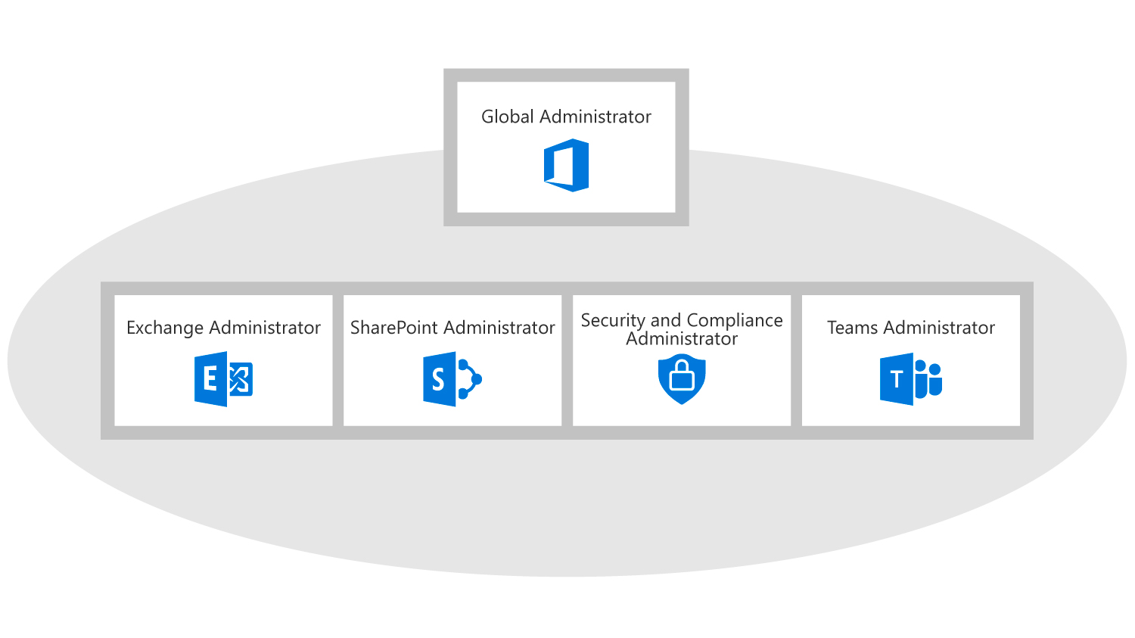
Using Admin Roles In Microsoft 365
In Microsoft 365 you use administrator roles to assign specific administrative functions to users
Each admin role maps to common business functions and gives permissions to do specific tasks in the Microsoft 365 admin center
You can manage admin roles in Microsoft 365 using the Microsoft 365 admin center or Windows PowerShell. Key roles include:
Global administrator
Billing administrator
Dynamics 365 Service administrator
Exchange administrator
Password administrator
Skype for Business administrator
Power BI administrator
Service administrator
SharePoint administrator
User Management administrator
Notes:
Mention how the diagram illustrates the relationship between the service admin roles and the Global admin role

Slide 26
SharePoint Administrator
The Microsoft 365 SharePoint Administrator role contains permissions for managing all aspects of the SharePoint Online product
Some of the key responsibilities assigned to the Microsoft 365 SharePoint Administrator role are:
Site collections
InfoPath
User profiles
BCS
Term store
Records management
Search
Secure store
Apps
Settings
Configure hybrid

Slide 27
Leveraging FastTrack and Partner Services

Slide 28
Lesson Introduction
Before using FastTrack, you should have a good understanding of what is required for leveraging FastTrack and partner services

Slide 29
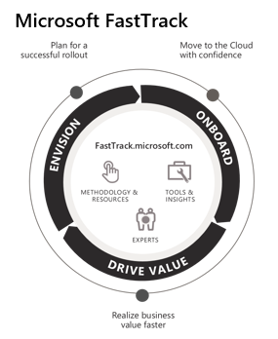
Introduction to FastTrack
FastTrack provides an organization with personalized assistance at any time, as long as its subscription is active
FastTrack for Microsoft 365 offers:
An ongoing, repeatable benefit included in an organization’s subscription
End-to-end guidance from Microsoft engineering or approved partners
Online resources and tools for all customers using Microsoft 365, Azure, or Dynamics 365

Slide 30
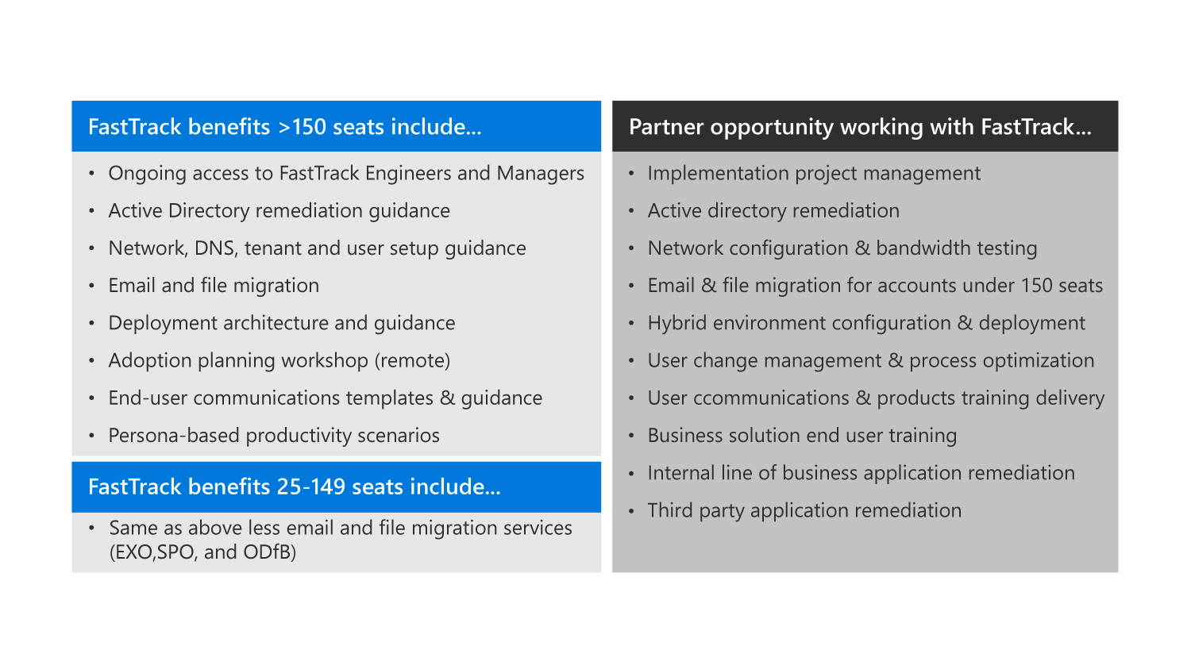
FastTrack Requirements
The FastTrack Center provides assistance for the following Microsoft 365 services:
Exchange Online
SharePoint Online
OneDrive for Business
Skype for Business Online
Microsoft Teams
Power BI
Project Online
Yammer Enterprise
Microsoft 365 Apps for enterprise
Microsoft StaffHub

Slide 31
Requesting a Partner
When looking for a partner to assist you with the FastTrack process, you should begin by accessing the I’m looking for a solution provider website
The website displays a list of partner candidates that you can choose from
Once the onboarding process is complete, you can see your partner’s information in the Partner Services tab

Slide 32
Lesson Introduction
This lesson examines key components and tasks related to Microsoft 365, such as:
Microsoft 365 Components
Microsoft 365 Subscription Options

Slide 33
Microsoft 365 Subscription Options
Microsoft 365 Business
Targets small to medium-sized organizations that require cloud collaboration and have up to 300 users. Includes the following subscriptions:
Microsoft 365 Apps for Business - Includes fully installed Office apps, but it does not include email, instant messaging, and HD video conferencing.
Microsoft 365 Business Basic - Does not include full versions of the Office apps, but it does include email with a 50-GB mailbox per user, instant messaging, and HD video conferencing for up to 250 users.
Microsoft 365 Business Standard - Includes fully installed Office applications, email, Azure AD, Azure information protection, Exchange Online advanced threat protection, Intune, MDM, and Windows 10.
Microsoft 365 Business Premium- Includes both fully installed Office applications and email with a 50-GB mailbox per user, instant messaging, and HD video conferencing.
Notes:
See the topic which contains description of the similarities and differences between E1, E3, and E5. Discuss these with the class/

Slide 34
Microsoft 365 Subscription Options (continued)
Microsoft 365 Enterprise
Targets medium-sized and enterprise organizations that need a cloud collaboration solution, compliance tools, a corporate social network, an intranet site and web conferencing, and the ability to include an unlimited number of users. Includes the following subscriptions:
Office 365 E3 - Includes business services such as email, file storage and sharing, Office for the web, and meetings and IM, plus the ability to install Office applications locally, as well as application enterprise management, self-service business intelligence, and compliance tools.
Office 365 E5 - Includes all E3 features, plus advanced security, analytic tools, public switched telephone network (PSTN) conferencing and cloud PBX (private branch exchange) for cloud-based call management.
Office 365 F3 - Designed for Firstline Workers. It does not include a license to install Office applications locally; this is a cloud-based subscription that only provides access to online versions of Office.
Microsoft 365 Apps for enterprise – (formerly Office 365 ProPlus) Includes online versions of Office, cloud file storage, and sharing capabilities with 1 TB storage per user. Also includes the option to fully install Office applications locally.
Notes:
See the topic which contains description of the similarities and differences between E1, E3, and E5. Discuss these with the class/

Slide 35
Microsoft 365 Subscription Options (continued)
Microsoft 365 Education
Provides cloud productivity and collaboration solutions for students and teachers.
Includes online versions of Office, cloud file storage, and sharing capabilities with 1 TB storage per user.
Includes email with a 50-GB mailbox per user, instant messaging and Skype connectivity, team sites, school video portals, online classes with audio and HD video conferencing, Yammer for school social network, and compliance tools.
Enterprise Mobility + Security
Add-on service that can be added to the Office 365 E3 and E5 subscriptions.
Provides options to protect against unknown device intrusions, malware threats, and additional identity protection.
When added to a Office 365 E5 subscription, Cloud App Security and Azure Advanced Threat Protection (ATP) are also included.
Notes:
See the topic which contains description of the similarities and differences between E1, E3, and E5. Discuss these with the class/

Slide 36

Enterprise Mobility and Security Components
EMS contains the following services that focus on data and identity protection, as well as protection again unknown device intrusion and malware threats:
Microsoft Azure Active Directory
Azure AD Premium P1 edition
Azure AD Premium P2 edition
Azure AD Identity Protection
Azure AD Privileged Identity Management
Azure Information Protection
Microsoft Intune

Slide 37
Planning Your Microsoft 365 Subscription
An organization should consider the following questions when it plans to purchase a Microsoft 365 subscription:
Which business needs will drive the organization to move to Microsoft 365?
What is the organization’s current IT infrastructure?
What is the organization’s change-management process?
How many employees will use Microsoft 365 and what are the organization’s plans for growth?

